Slide 1



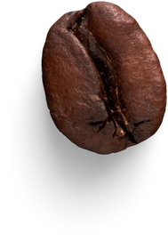

The Daily Grind
SWOT ANALYSIS
The Daily Grind Coffee Shop
The Daily Grind – local small, independent artisanal coffee shop known for high-quality coffee & friendly, skilled baristas
Analyst: Jitendra Manasingh
@Analytical Framework

Slide 2


About Cafe
“The Daily Grind,” a small independent coffee shop known for high-quality artisanal coffee and friendly baristas. We have a loyal customer base of local residents and professionals, but our café is small and often crowded during peak hours. We currently lack a mobile pre-ordering app, and our marketing is limited to a basic Instagram page.
A major international coffee chain is opening nearby, increasing competition. However, a newly opened office building next door brings hundreds of potential customers daily. Rising coffee and milk costs are impacting our profits, but the growing “shop local” trend presents an opportunity to strengthen our community presence.

Slide 3

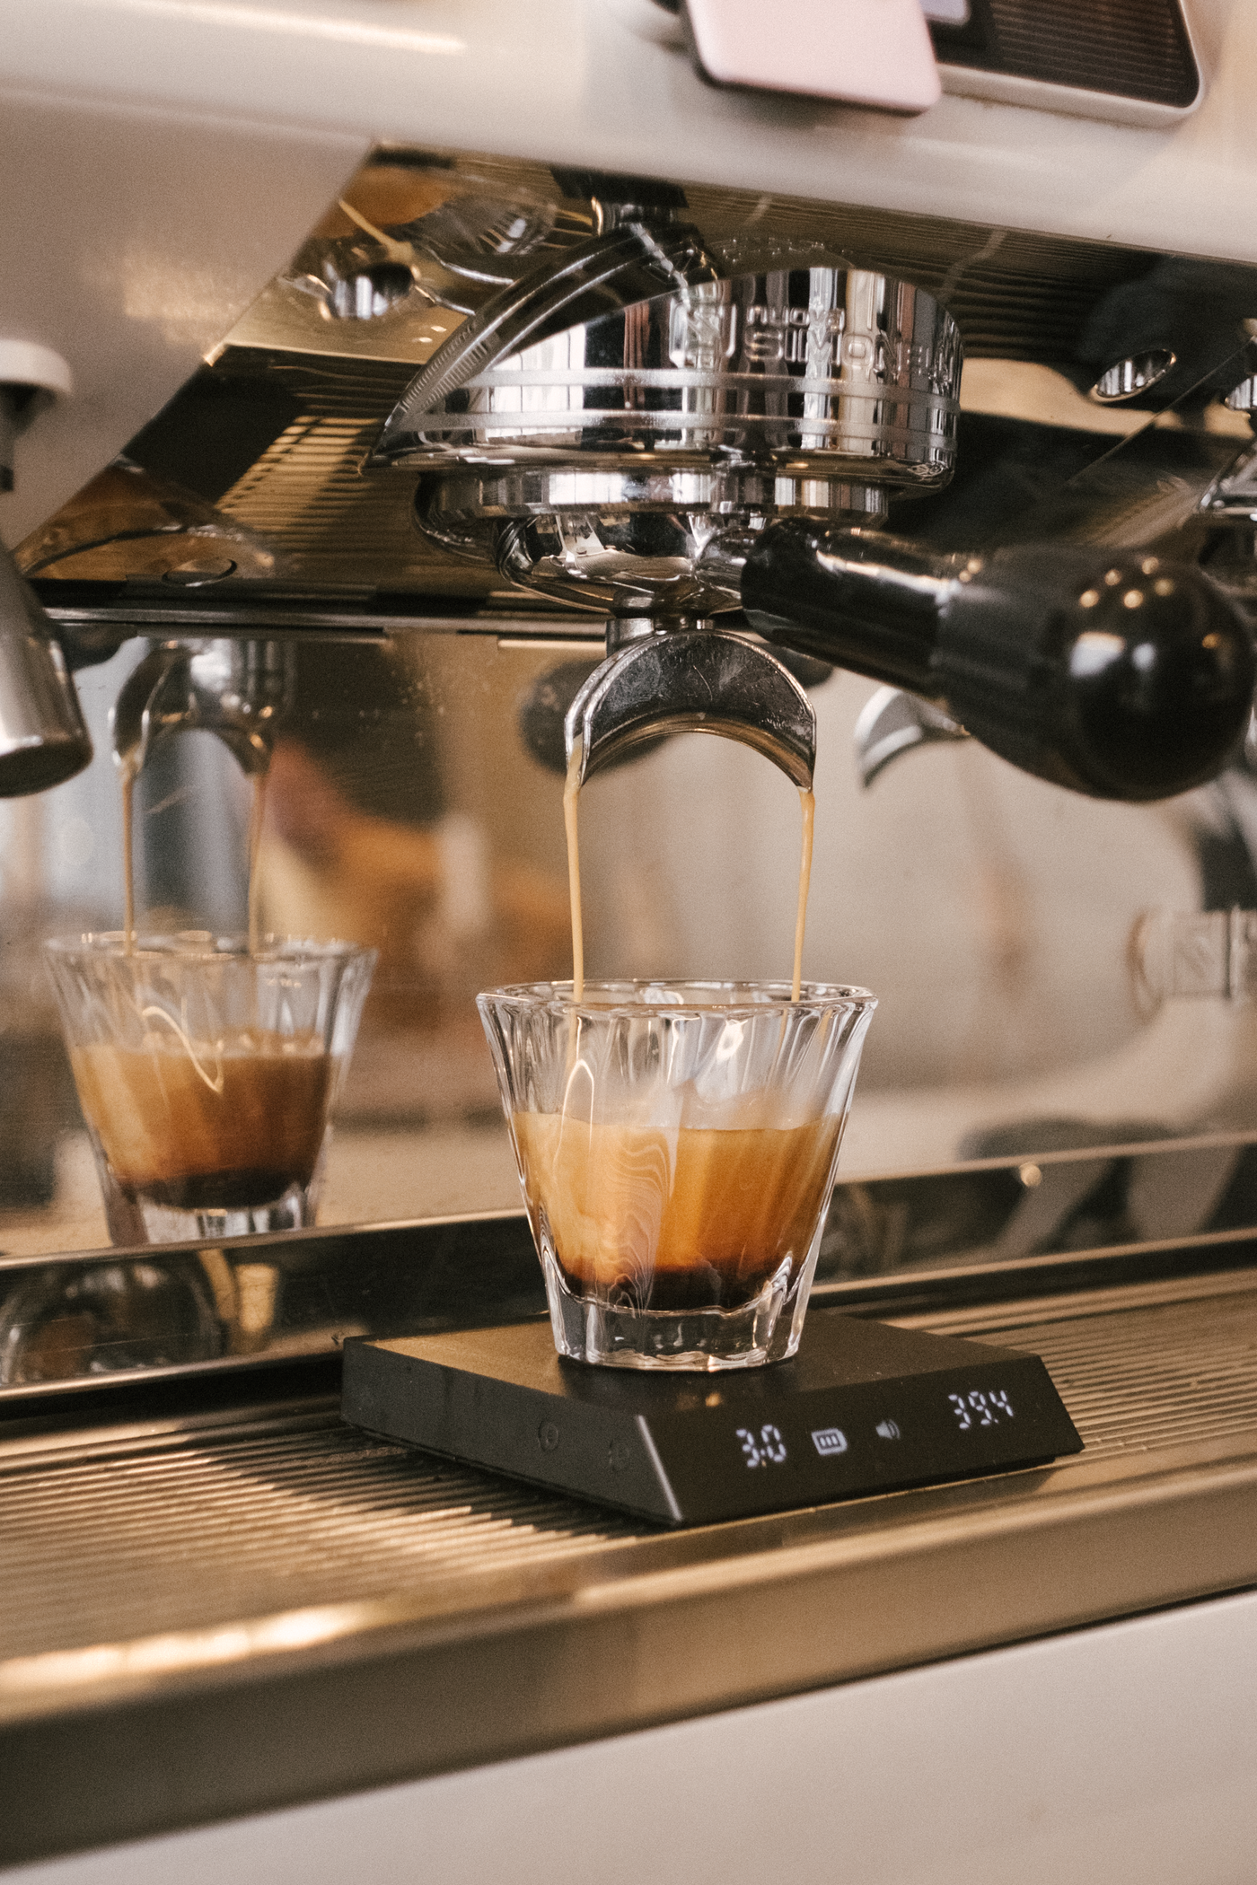

Why This SWOT?
Identify Strengths, Weaknesses, Opportunities & Threats
Support future growth strategy.
Enhance Competitive Advantage
Facilitate Decision-Making

Slide 4
Business Profile
Core Highlights
Famous for artisanal coffee
Loyal customer base (local residents & professionals)
Cozy café space (but limited seating)
Marketing: Instagram page only
Challenge
No pre-order mobile app

Slide 5
SWOT Analysis
Strengths
Advantages
Disadvantages
Weaknesses
Quality of products and customer loyalty.
Skilled and friendly staff.
Limited marketing & technology use (no mobile app).
Small space causing congestion.
Opportunities
Threats
Potential Growth Areas
External Challenges
Expansion potential with new local customers.
Trend towards shopping local.
Increased competition from large coffee chains.
Rising operational costs.

Slide 6
Strengths
High-Quality Products: 80% of customers rate the coffee quality as excellent.
Loyal Customer Base: 70% of total sales come from repeat customers.
Skilled Baristas: 90% customer satisfaction with barista service, based on feedback surveys.

Slide 7
Weaknesses
Limited Space: 50% of customers report feeling crowded during peak hours.
Lack of Pre-Ordering: 30% of potential customers prefer shops with mobile ordering options.
Basic Marketing: 10% engagement rate on Instagram, indicating low brand visibility.

Slide 8
Opportunities
New Office Building: Potential to attract an estimated 200 new daily customers, increasing foot traffic by approximately 25%.
Local Trend: 60% of local customers show preference for shopping at small businesses, presenting a marketing opportunity.
Mobile Ordering: Implementing a mobile app could increase sales by 15% through pre-orders.

Slide 9
Threats
New Competitor: 100% certainty of competition from the major coffee chain, which will have extensive marketing reach.
Rising Costs: Recent price increase of premium coffee beans has cut profit margins by approximately 10%.
Changing Consumer Preferences: 20% of customers may switch to larger chains due to convenience or perceived value

Slide 10
Strategic Recommendations
Leverage Strengths and Opportunities:
Introduce a mobile app for pre-ordering to enhance customer convenience and optimize peak hour traffic.
Utilize local marketing campaigns that highlight the shop's artisanal coffee and community-focused values to attract new customers from the office building.
Address Weaknesses:
Consider expanding the cafe space or optimizing layout to better accommodate peak hours and reduce crowding.
Implement a social media strategy that engages customers and promotes special promotions, making the brand more visible
Mitigate Threats:
Differentiate the menu by offering unique seasonal drinks and bakery items that competitors do not provide,
creating a niche market.
Monitor coffee supply costs and explore local sourcing options to manage expenses effectively without sacrificing quality.

Slide 11
The Daily Grind
THANK YOU

Slide 12
SWOT Analysis
Core Customer Values
Operational Growth Barriers
High-Quality Coffee
Skilled Baristas
Customer Loyalty
Community Brand
Small Space
No Mobile App
Limited Marketing
Profit Margin Pressure
Expansion & Partnerships
Market & Economic Pressures
New Office Building
Shop Local Trend
Mobile App Development
Partnerships
International Chain
Rising Costs
Customer Loss
Economic Downturn

